Slide 1
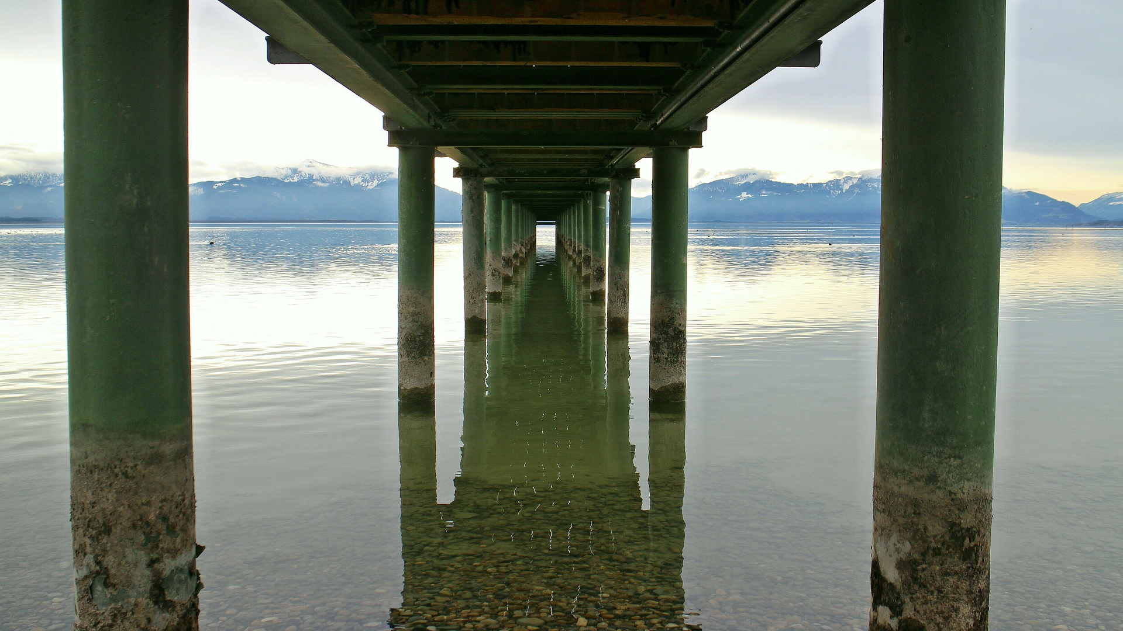
THE HUMAN DESKTOP
BQ1 Foundations Lesson 11
I can explain why it is an advantage not to see the world as it actually is
Notes:
See how this lesson links to the course by viewing the final slide
Key TOK terms appear in a red font

Slide 2
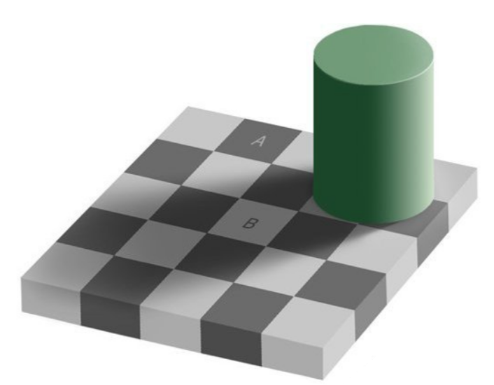
Starter
What observations can you offer about squares ‘A’ and ‘B’?
Specifically, are they the same shade of grey?
Notes:
Animated slide. The greys are, of course, the same.
Illusion created by Edward H. Adelson

Slide 3
Not convinced… ?
Watch the illusion animated in this article...
Notes:
Vew the illusion animated within this Vox article - scroll half way down to access it.

Slide 4
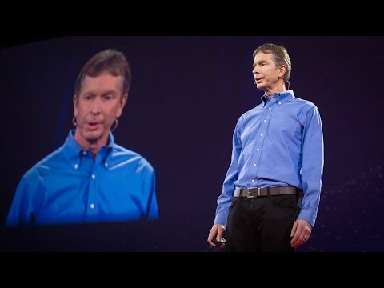
The construction of reality
Copy down Donald Hoffman’s quote: “It feels like we're just taking a snapshot of this room the way it is, but in fact, we're constructing everything that we see”?
How does he illustrate what he means?
Notes:
Video is here.
Clip 1 = 1.50 - 5.45

Slide 5
WHY?!!
With a partner or on tables, create a hypothesis to explain why we construct reality (as seen with visual illusions), rather than see reality as it actually is.
Notes:
Go through these in some detail.

Slide 6
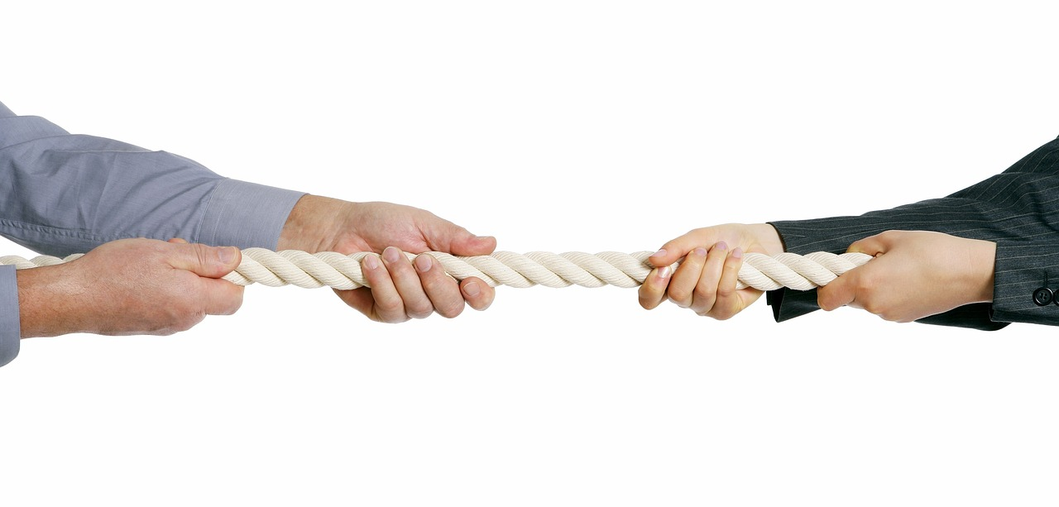
Group creative task
Create a “metaphor” for how our sense perception and our brains work
Show your ideas on one half of the A3 paper
Notes:
Images show the kind of thing they could come up with, but students will be quite creative with what they come up with.

Slide 7
“How can not perceiving reality as it is be useful?”
What metaphor does Hoffman use to answer the question?
Add his metaphor to your one. How does it compare to yours? (think about which one is more complete and clear)
Notes:
Continue same video - here.
Clip 2 = 11.50 - 14.00
Answer - The desktop of a computer. It is much clearer than seeing the internal workings of a computer. The better the computer, the clearer, more simple, user friendly the interface is - not the closer to the reality of how the computer works.
The next three slides show the evolution of the desktop; our sensory perception has evolved in exactly the same way.

Slide 8
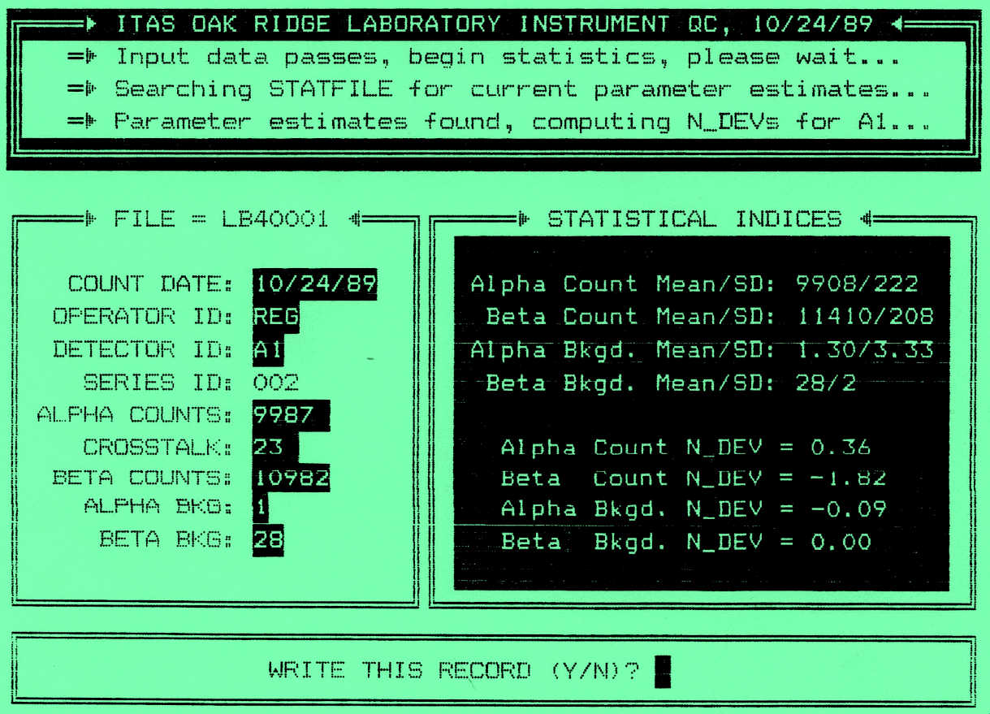
Notes:
The evolution of Apple interfaces (1)

Slide 9
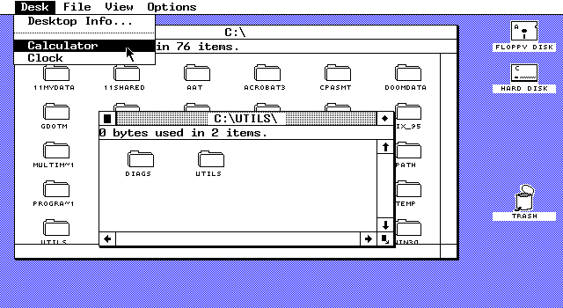
Notes:
The evolution of Apple interfaces (2)

Slide 10
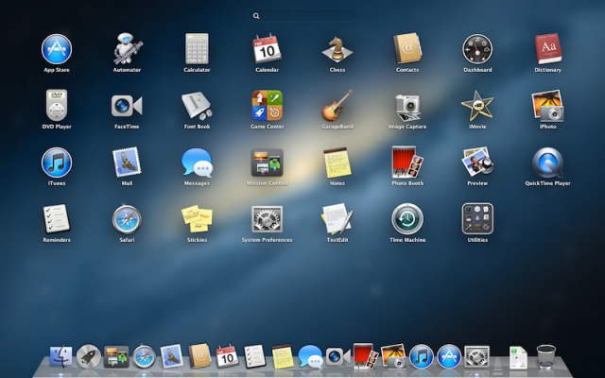
Notes:
The evolution of Apple interfaces (3)

Slide 11
Group debrief
Compare your hypothesis and metaphor with that of Hoffman.
What are the similarities and differences?
Is one a better hypothesis/ metaphor than the other - why?

Slide 12
Links to the TOK exhibition
Related exhibition prompt Are some things unknowable (IAP-18)?
Refer to the ideas from this lesson to answer this question.
For example, can we ever ‘know’ reality, or can we only ever access a tiny part of it?
Which objects could help to illustrate your answer?
Notes:
Optional slide, if you want to help students to take ownership of the IA prompts (IAPs) for the TOK exhibition
For more ideas on relevant IAPs, see the ‘Linking this lesson to the course’ slide

Slide 13
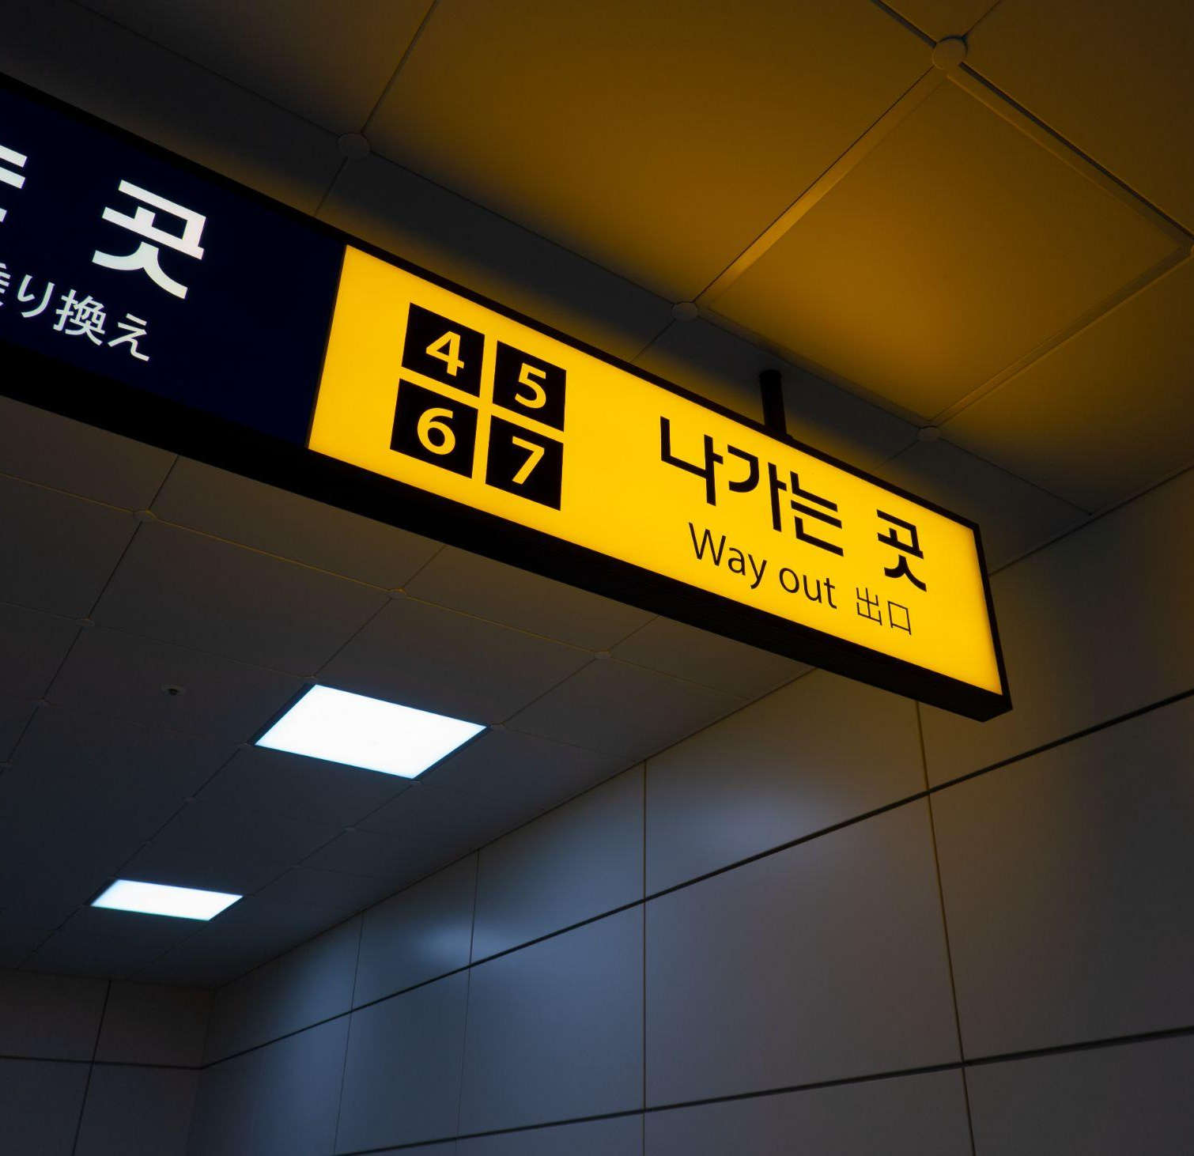
“evolution has given us an interface that hides reality and guides adaptive behavior… perception is not about seeing truth, it's about having kids.”
What does Hoffman mean? (tip: use the word ‘survival’ in your answer).
What are the implications of this in terms of the way we ‘see’ reality? (tip: use the word ‘streamline’ and/or ‘hack’ in your answer)
Notes:
See the BQ1 assessment tracker for suggestions on providing feedback, and recording students’ progress

Slide 14
Linking this lesson to the course
During this lesson, we consider the highlighted aspects of the TOK course
The images used in the presentation slides can also give students ideas about selecting exhibition objects; see also our link below to specific IA prompts
CORE THEME | OPTIONAL THEMES | AREAS OF KNOWLEDGE | TOK ASSESSMENT
Knowledge & the knower | Indigenous societies | The arts | The TOK essay
 | Language | History
 | Politics | The human sciences | The TOK exhibition Could be linked to IAP-18 (unknowable), IAP-20 (experience), IAP-30 (imagination)
 | Religion | Mathematics
 | Technology | The natural sciences

Slide 15
Explore the TOK themes and areas of knowledge in more depth via a range of thinkers, media sources, and other resources, in our EXPLORATION POINTS DOCUMENTS.
Access the documents via the links below. You’ll also find the EP icons on all of the TOK course pages of the site to help you unpack the quotes, KQs, and real-life situations that you find there.
CORE THEME
Knowledge & the knower
OPTIONAL THEMES
Indigenous societies
Language
Politics
Religion
Technology
AREAS OF KNOWLEDGE
The arts
History
Human sciences
Mathematics
Natural sciences
Notes:
Use this slide to access the ‘Exploration Points’ notes for BQ1, which will help students to develop a deeper knowledge of any TOK theme or area of knowledge. This will not only help them to master the TOK course in general, but also craft a great exhibition or essay.
Be ready to provide more guidance on how to use this resource - ie, which media sources to focus on, which questions to address, which TED talks to watch, and which key terms and ideas to understand.

